Slide 1
ADABOOST Regressor
Adaptive Boosting, is a meta-algorithm that combines many "weak learners" to create a single, highly accurate "strong learner.

Slide 2
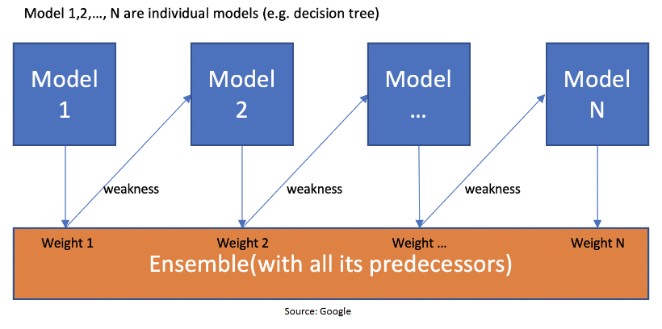
HOW IT WORKS!

Slide 3
step-by-step PROCEDURE
Initialize sample weights- every dataset given equal weight.
Train the first weak learner- train simple decision tree
Calculate the error- difference between the predicted and actual values.
Update sample weights- higher the error ,higher the weight(Adaptive)
Train the next weak learner- focus on the points where the previous model struggled.
Calculate the model's influence &Repeat- calculates a weight for the newly trained regressor based on its overall performance
Combine the weak learners- weighted average of all the weak learners' predictions.

Slide 4
implementation
class sklearn.ensemble.AdaBoostRegressor(estimator=None, *, n_estimators=50, learning_rate=1.0, loss='linear', random_state=None)
Parameters:
n_estimators =int, default 50
loss{‘linear’, ‘square’, ‘exponential’}, default=’linear’
random_state=int, RandomState instance or None, default=None
Import
from sklearn.ensemble import AdaBoostRegressor

Slide 5
Advantages & Applications
Advantages
Improved Accuracy
Robust Performance
Feature Importance
APPLICATIONS:
Financial Modeling: Predicting stock prices or credit risk scores
Energy Forecasting: Estimating power consumption or generation levels
Healthcare Analytics: Predicting patient outcomes or required resource allocation.

